Slide 1
TruckTrackerTM - Brazil

Slide 2
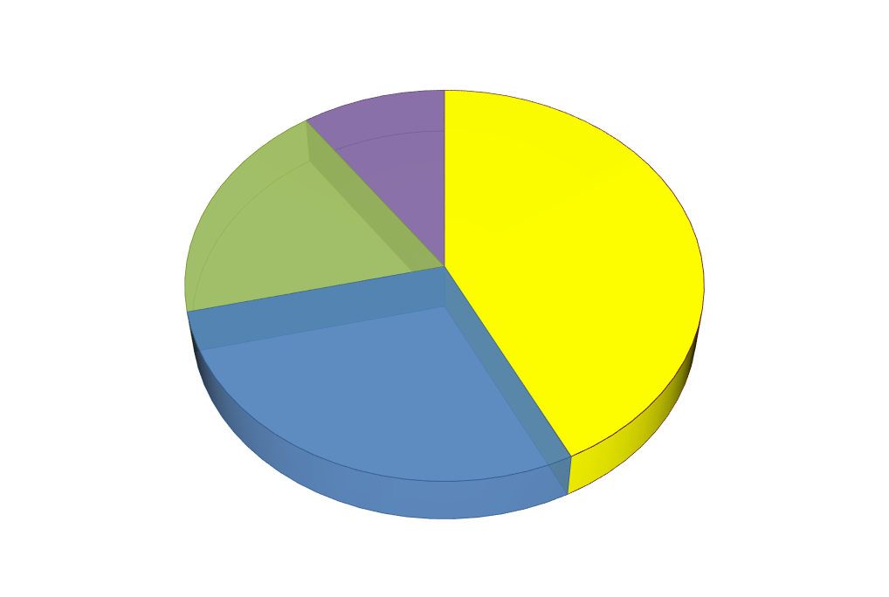
Survey Content

Slide 3
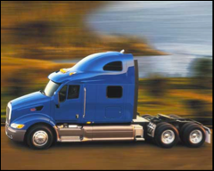
Methodology
Interviews distribution and Schedule
Interviews Content
Interface sample

Slide 4
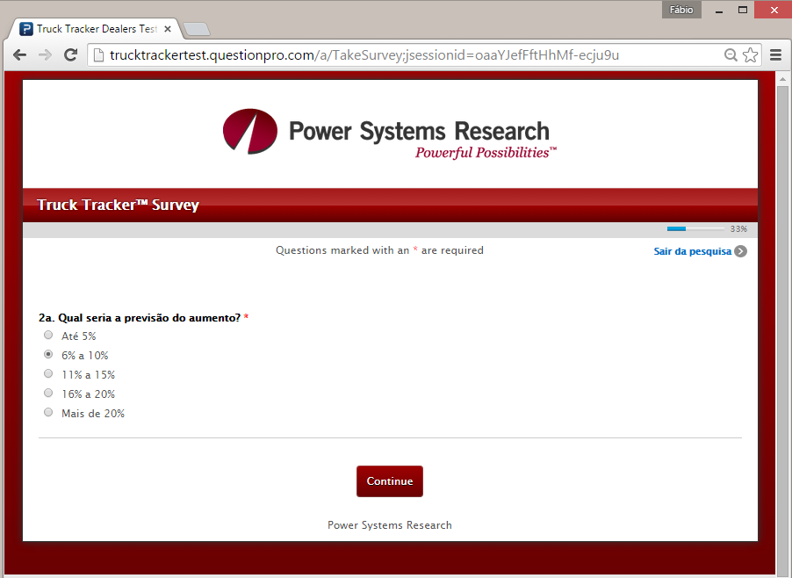
CAWI / CATI / CAPI - Interface example

Slide 5
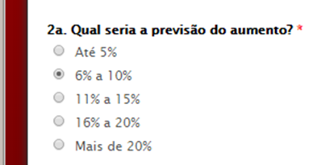
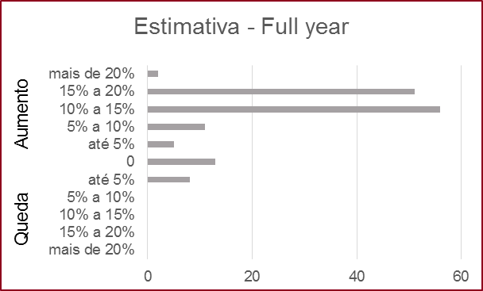
Research confidence interval
Fidelity with dealers and buyers perspective
Intervals of 5% enough for quick corrections purposes
Histogram for variance analysis
Tight confidence intervals and error margin
 | Dealers | Fleet Companies
Population | 1.000 | 500.000
size
Confidence Interval: | 99% | 99%
Sample = Population
Population distribution: | Homogeneous | Heterogeneous
Sample size: | 97 | 42
Sample Error: | 10% of interval or ± 0,5% | 20% of interval or ± 1,0%
Research Error Margin:

Slide 6
Results – From Dealers

Slide 7
Results – From Fleet Owners

Slide 8

Data Access

Slide 9
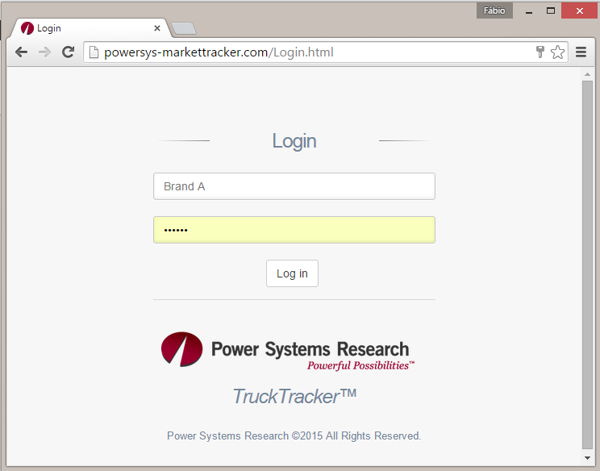
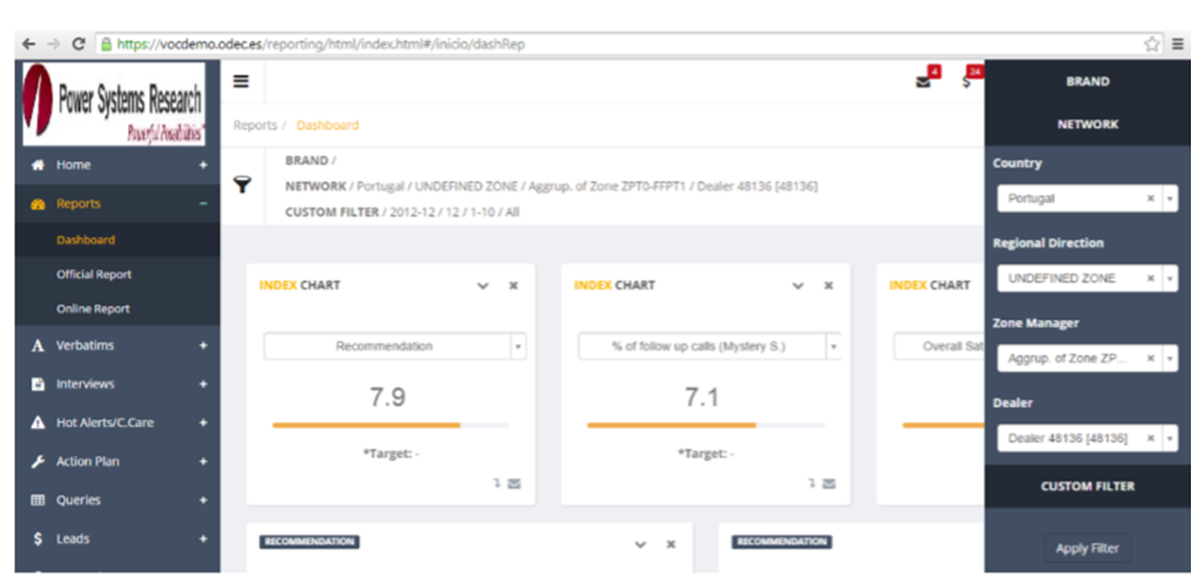
Data Access via Web Portal – 3 levels of access
  Level 1 – Respondents and Press
    10 charts – free website
  Subsciber Level 2 – Tier 1: OEM Supplier
    25 Charts / Analysis
    No brand - Same info for all Tier 1 all OEM
    Export data to Excel
  Subscriber leve 3 – OEM
    50 charts / Analysis done by PSR
    Detailed and unique info - by Brand
    Comparison OEM Brands vs. Average
    Customization possibility – more analysis
    Quality / Satisfaction insights
    Export data to Excel
    Assure 30 respondents for each subscriber
Customer Portal – WEB:
powersys-markettracker.com

Slide 10
Thank you

